Slide 1


Titolo presentazione sottotitolo
Pixel-Wise Classification of Multispectral Satellite Images Using Machine Learning
Milano, XX mese 20XX
Author: Liang Zhongyou
Advisor: Ludovico Giorgio Aldo Biagi

Slide 2
Introduction
This project (Pixel-Wise Classification of Multispectral Satellite Images Using Machine Learning), focuses on the development of a cloud-based application for pixel-wise classification in multispectral satellite images through machine learning methods. The tool provides both supervised(k-nearest neighbors algorithm with Euclidean distance)and unsupervised(K-means) classification options.
The primary objective of the project is to streamline the process of image classification, generating results in a user-friendly graphical interface.
Link of the project running:
https://satellite-image-classification-cpguc5dgbghmcyfd.germanywestcentral-01.azurewebsites.net/
Link of the Code:
https://github.com/zyl009/Pixel-Wise-Classification-of-Multispectral-Satellite-Images-Using-Machine-Learning

Slide 3
Application Architecture
The application follows a client-server architecture. The user interface (UI) is built in HTML, CSS, and JavaScript, while the backend is powered by Flask (Python). The system allows users to upload GeoTIFF images, classify pixels, and download the classified results.

Slide 4
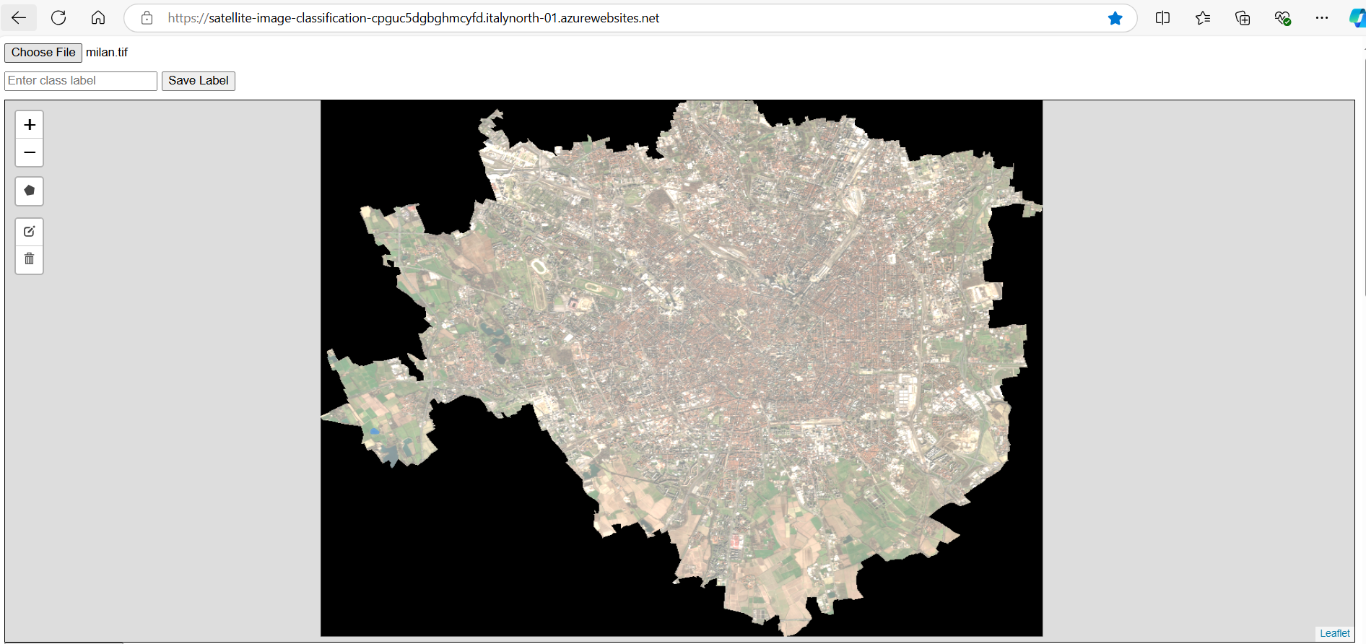
User Interface
This is the user interface of the application(after upload an image). The application can support from 8-bit to 64-bit GeoTiff file whose size less than 10MB to be uoloaded.
Link of the project:
https://satellite-image-classification-cpguc5dgbghmcyfd.germanywestcentral-01.azurewebsites.net/

Slide 5
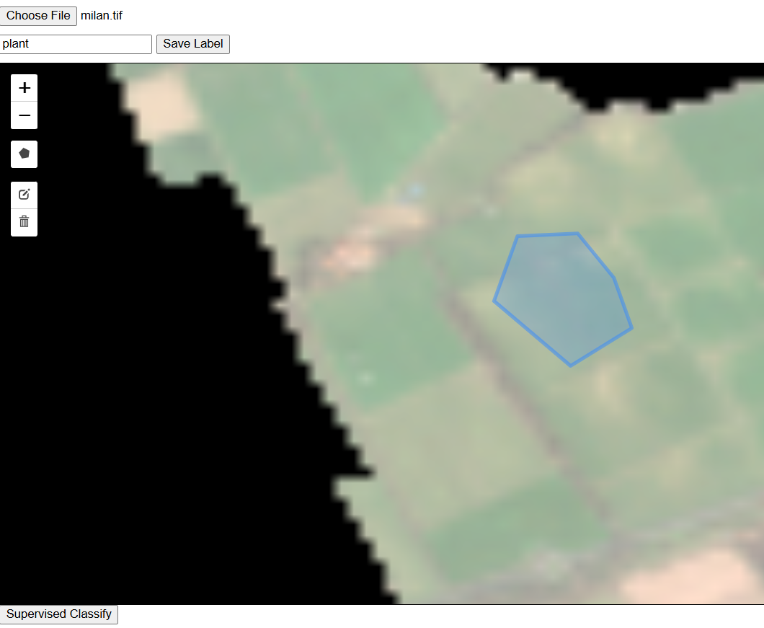
How to use
Supervised Classification:
Click “choose file” to upload an image.
Input a class label.
Click “draw polygon button”, then draw a polygon, click the first point in the end to close the polygon drawing.
Repeat 3 to finish the polygons drawing of this class. Then, enter a new class label to do next one.
When finish sample data selecting, click the “Supervised Classify” button.
View and download the result.

Slide 6
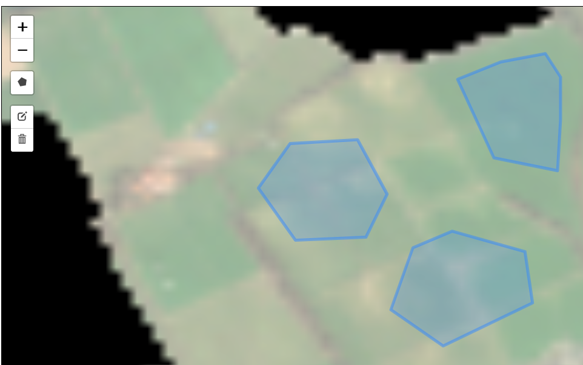
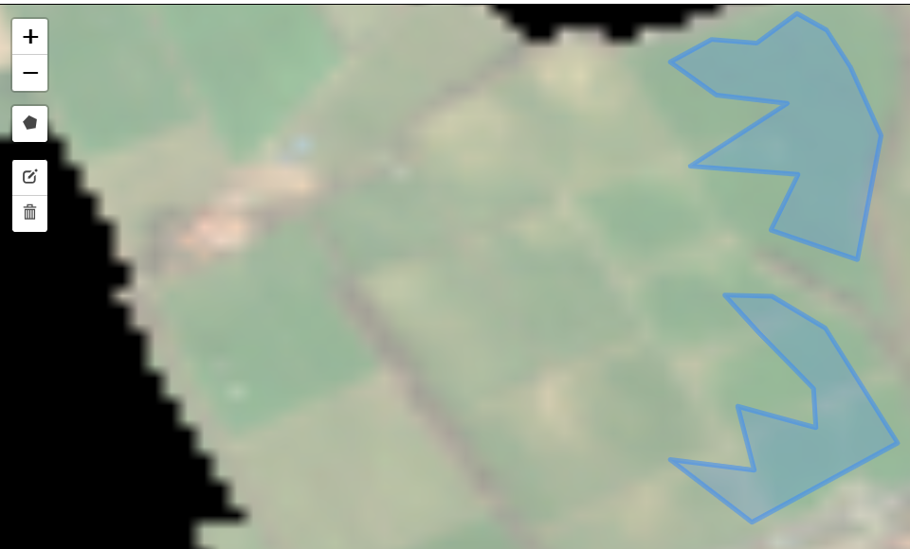
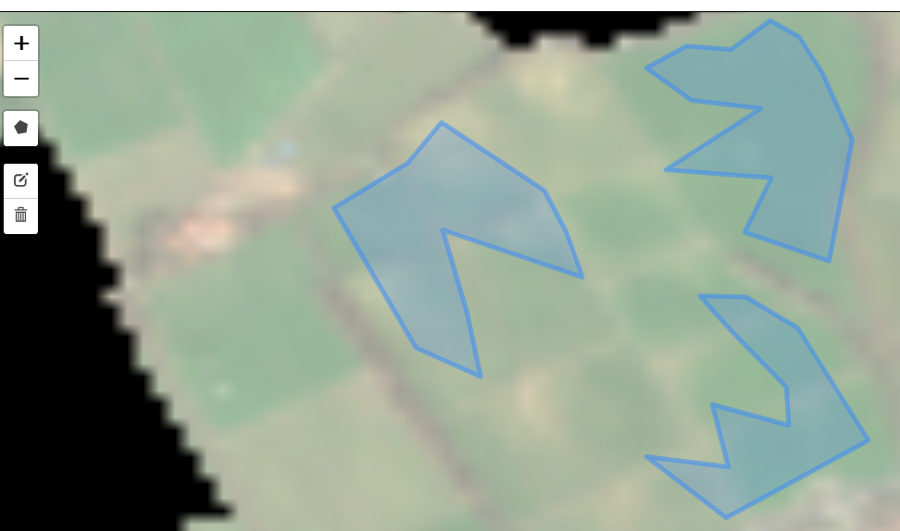
How to use
Supervised Classification(some notes):
1.During drawing polygons of one class , user can arbitrarily change the shape of the polygons and delete them before entering the new class label.
2.The processing time varies according to the image size and the number of samples selected.

Slide 7
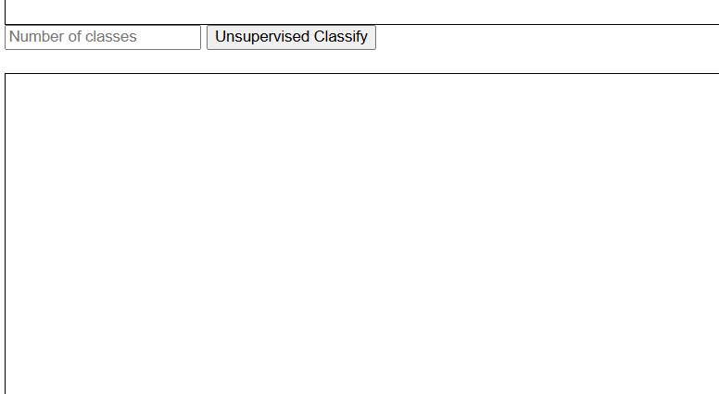
How to use
Unsupervised Classification:
Click “choose file” to upload an image.
Input the number of classes.
Click the “Unsupervised Classify” button.
View and download the result.

Slide 8
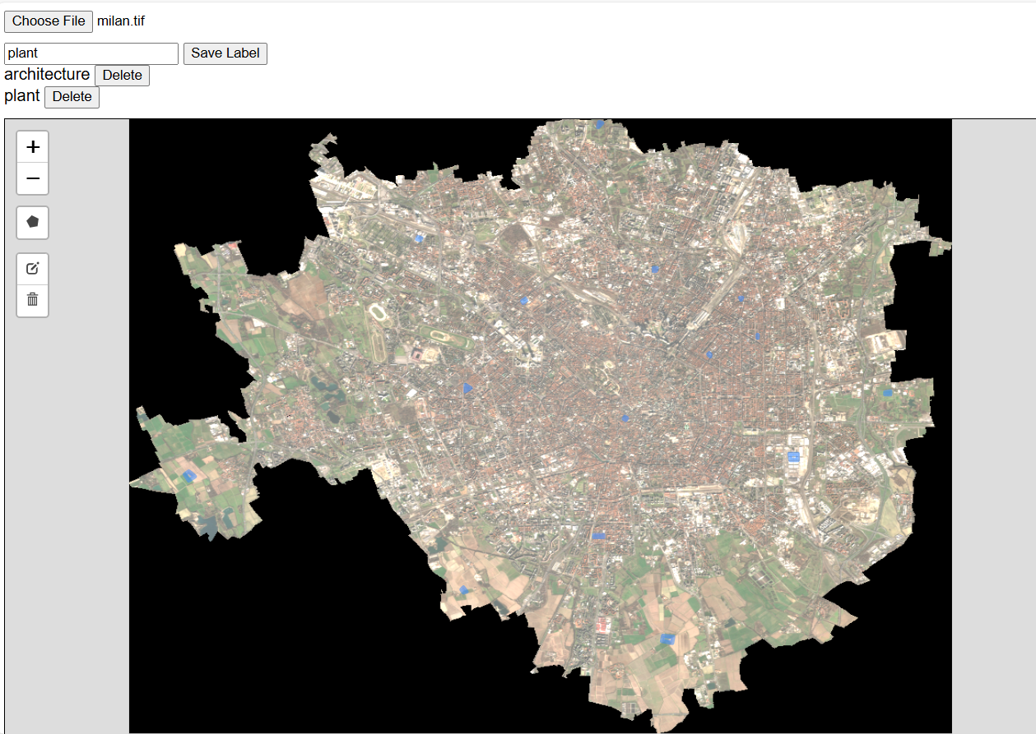
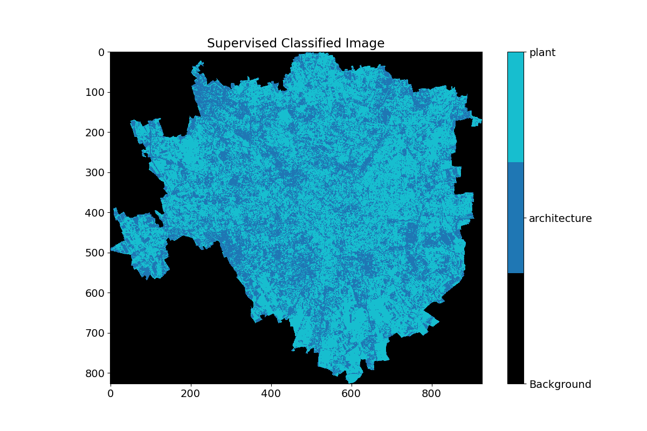
Classification Results
Supervised Classification
Upload image: a 5MB 32-bit RGB GeoTIFF image of Milan.

Slide 9
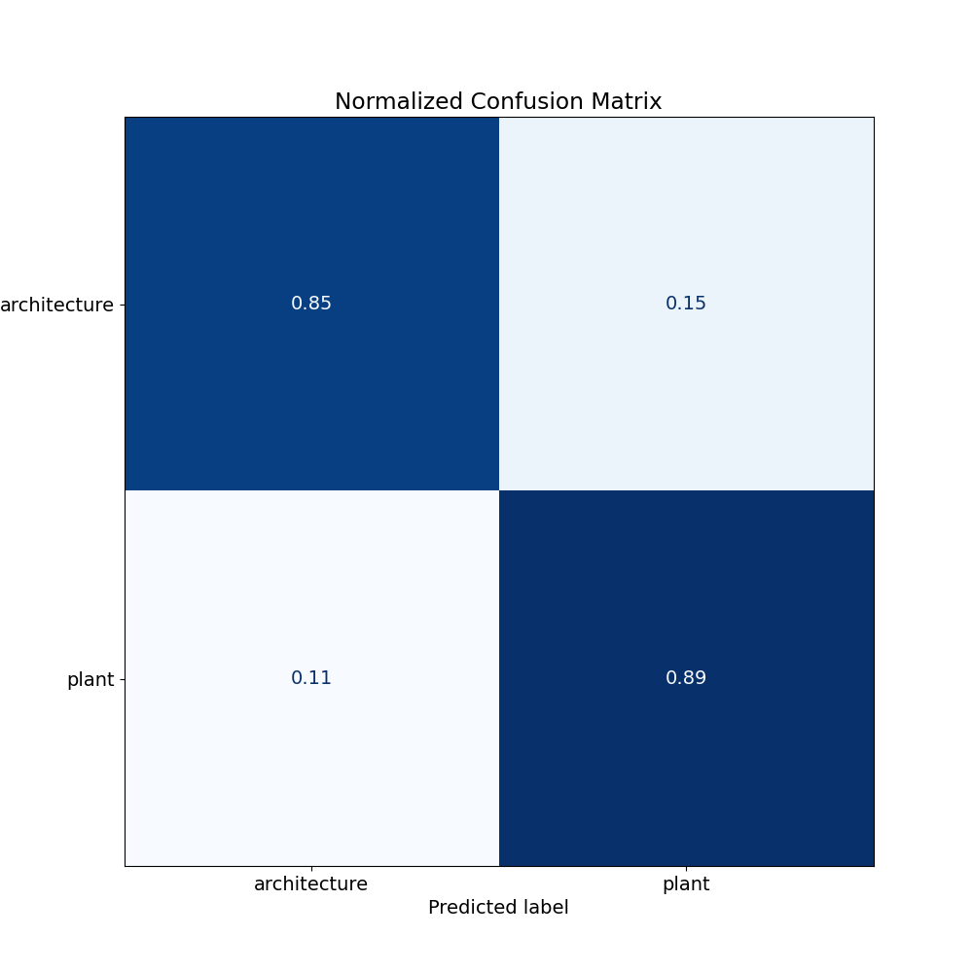
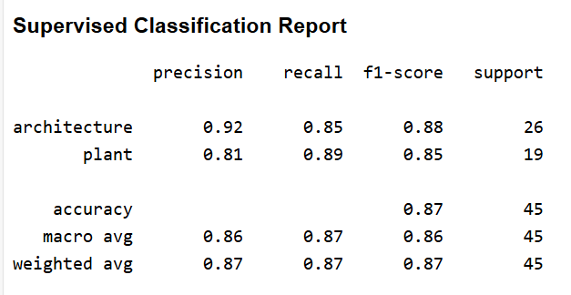
Classification Results
Supervised Classification

Slide 10
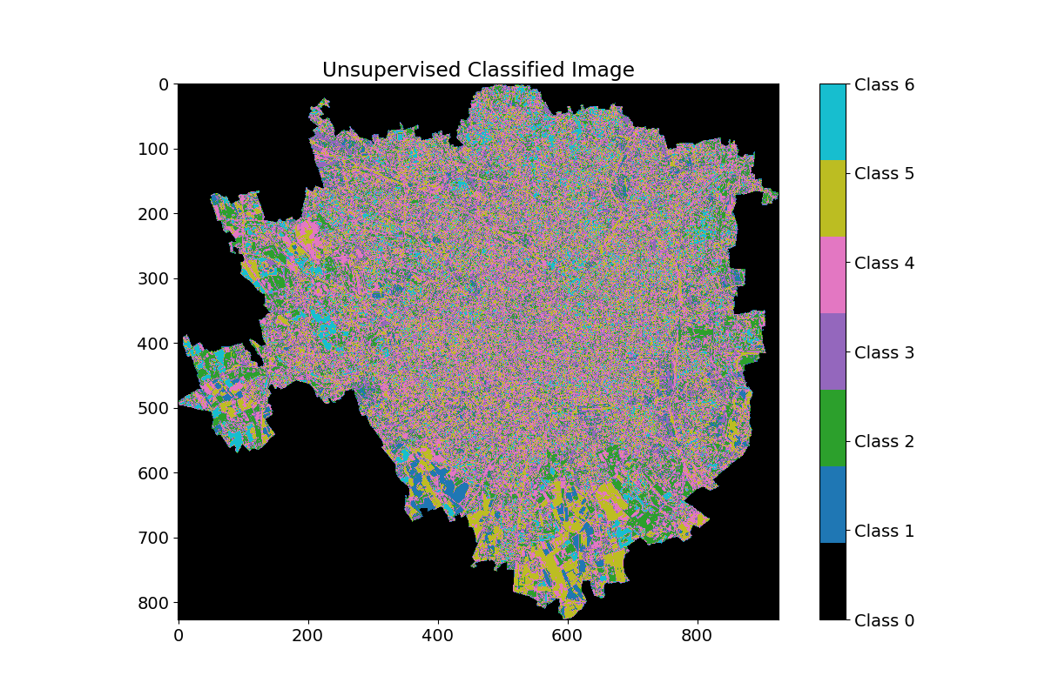
Classification Results
Unsupervised Classification

Slide 11
Conclusion
This application simplifies the process of pixel classification in multispectral GeoTIFF images. It offers both supervised and unsupervised classification options with an easy-to-use interface. The project demonstrates the feasibility of providing complex image classification capabilities to a wider audience without requiring expensive software or technical expertise.

